Slide 1
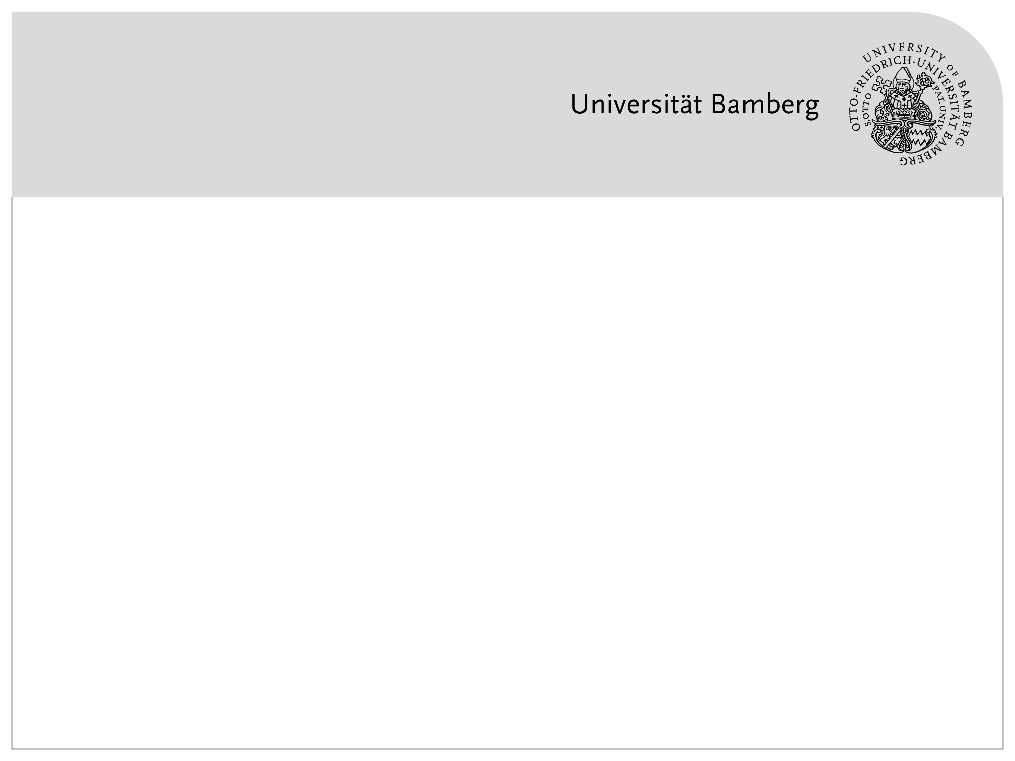
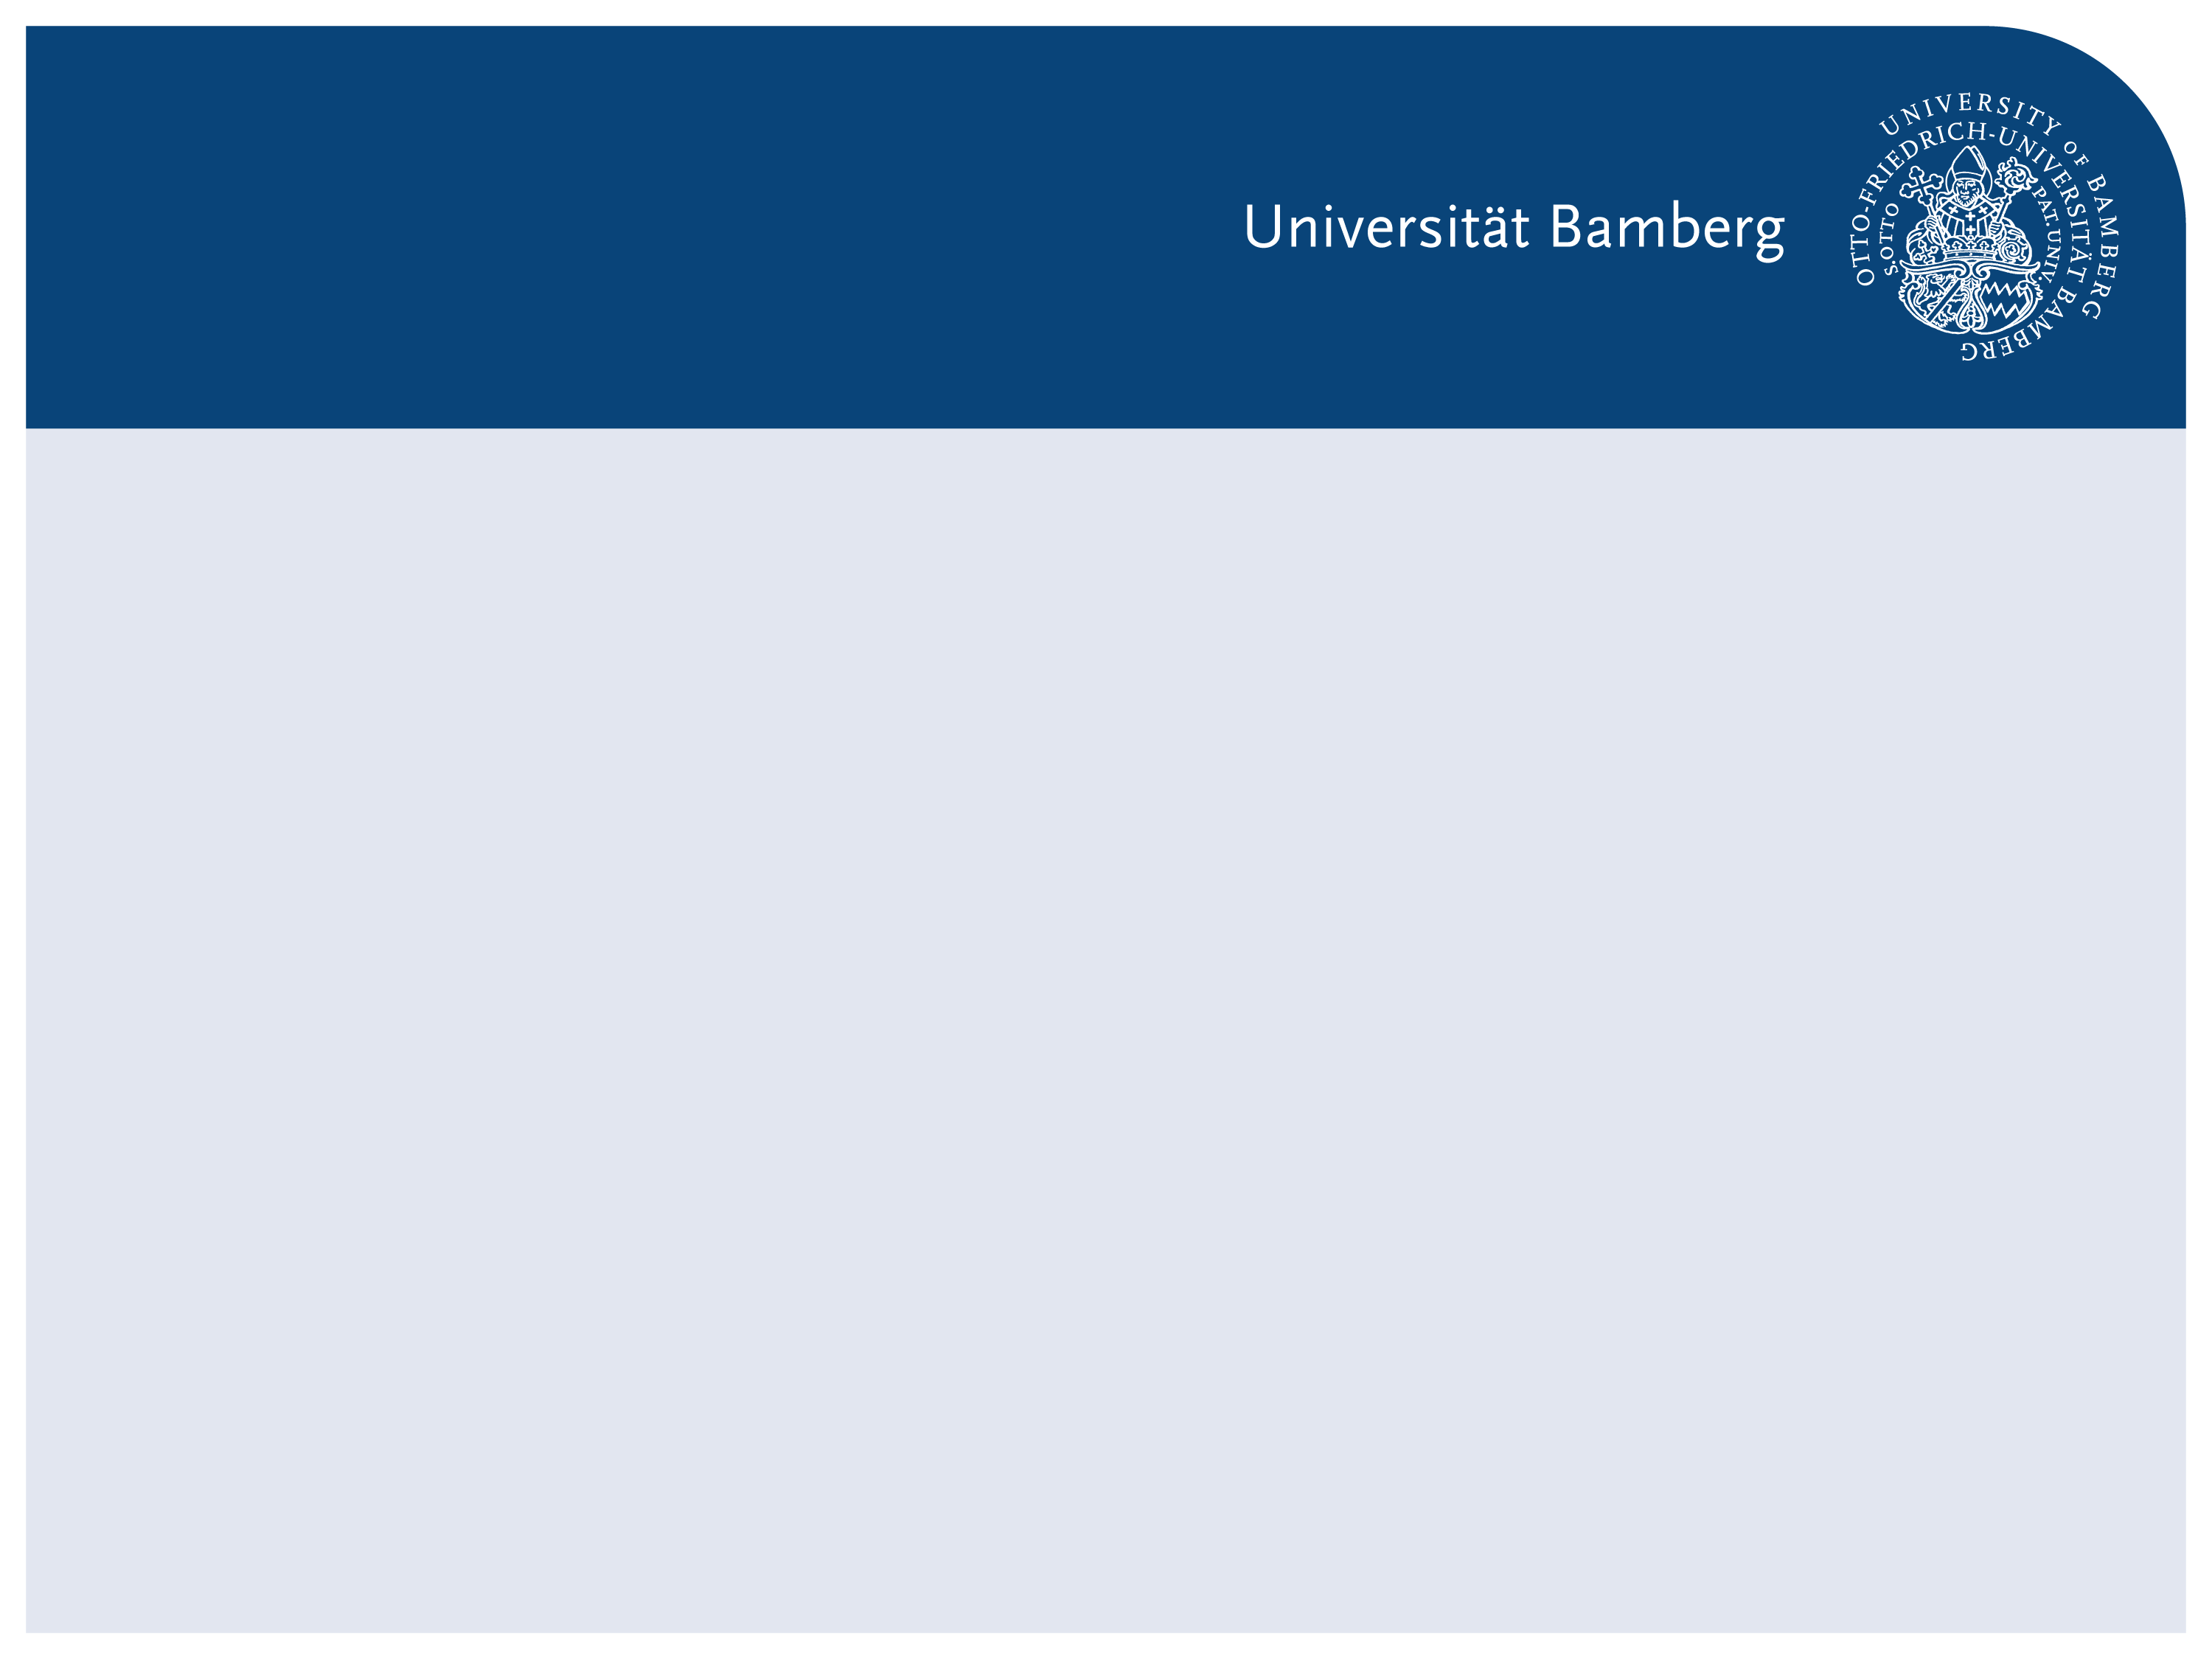
Understanding CNN Training Strategies for Image Classification
Intermediate Presentation – Explainable AI Project

Slide 2
Agenda / Outline
Part I:
Motivation & project background
CNN training intuition
Part II:
Model design & comparison (A–D)
Part III:
Result & Observation
Conclusion & Outlook

Slide 3
Part I — Project Motivation & Scope
Why understanding CNN training matters beyond accuracy
Comparing training strategies instead of architectures
Establishing strong baselines for later explainability analysis

Slide 4
Part I — CNN Training Intuition
What happens during CNN training?
Why training feels confusing at first
How forward, backward, and optimization work together

Slide 5
Part I — CNN Training Intuition
From Input Images to Predictions
Input images are processed in batches
The model outputs logits, not probabilities
A forward pass produces intermediate representations
outputs = model(inputs)

Slide 6
Part I — CNN Training Intuition
What Happens in a Forward Pass?
Convolution layers extract hierarchical features
Features become increasingly abstract
The final layer maps features to class scores

Slide 7
Part I — CNN Training Intuition
Why Do We Need a Loss Function?
Predictions alone are not enough for learning
The loss measures how wrong the prediction is
Cross-entropy connects logits with true labels
loss = criterion(outputs, labels)

Slide 8
Part I — CNN Training Intuition
Backward Pass: Learning from Errors
Gradients show how parameters affect the loss
Errors are propagated backward through the network
Each layer receives an update signal
loss.backward()

Slide 9
Part I — CNN Training Intuition
Optimizer: Actual Updating the Model
Optimizers use gradients to update weights
Learning rate controls update size
This step happens after backward pass
optimizer.step()

Slide 10
Part I — CNN Training Intuition
Putting Everything Together
Forward pass: compute predictions
Loss: measure prediction error
Backward pass: compute gradients
Optimizer: update parameters
outputs = model(inputs)
loss = criterion(outputs, labels)
loss.backward()
optimizer.step()

Slide 11
Part II — Model Design & Comparison
Why Do We Train Four Models?
Accuracy alone does not explain model behavior
Training strategy strongly influences learned representations
We systematically vary what is kept fixed and what is adapted

Slide 12
Part II — Model Design & Comparison
Two Key Design Dimensions
Pretraining source
ImageNet-pretrained
Flower-pretrained
Training strategy
Linear probing (frozen backbone)
Fine-tuning (trainable backbone)

Slide 13
Part II — Model Design & Comparison
Overview of Models A–D
 | Frozen backbone (linear probe) | Trainable backbone (fine-tune)
ImageNet pretrained | Model A | Model B
Flower pretrained (checkpoint) | Model C | Model D

Slide 14
Part II — Model Design & Comparison
Linear Probing vs Fine-Tuning
Linear probing keeps feature extractor fixed
Only the classification head is trained
Fine-tuning allows features to adapt to the new task

Slide 15
Part II — Model Design & Comparison
Why Different Pretraining Sources Matter
ImageNet provides generic visual features
Flower-pretraining emphasizes domain-specific patterns
Pretraining biases what the model focuses on

Slide 16
Part II — Model Design & Comparison
What We Expect to Learn from the Comparison
When is fine-tuning worth the extra complexity?
How transferable are pretrained features?
How sensitive are models to domain shifts?

Slide 17
Part III — Results & Observations
How to Read the Results
Accuracy summarizes performance, but hides behavior
Loss reflects learning dynamics during training
We focus on relative differences, not absolute numbers

Slide 18
Part III — Results

Slide 19
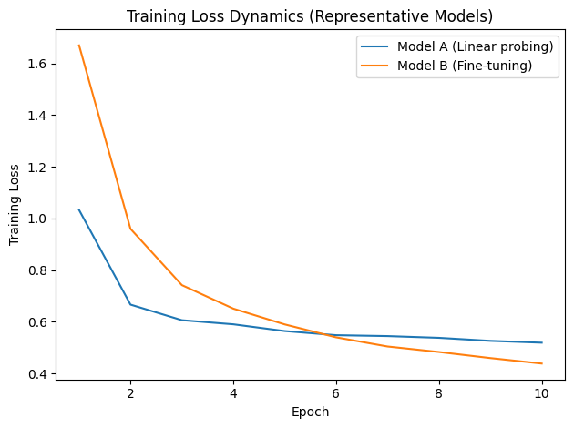
Part III — Results & Observations
Training Loss Dynamics
Fine-tuning shows a steeper loss reduction
Linear probing converges earlier during training
Loss curves highlight optimization dynamics

Slide 20
Part III — Results & Observations
Observed Patterns Across Models
Fine-tuning consistently leads to higher performance than linear probing
Linear probing converges earlier but saturates at a lower level
ImageNet-pretrained models show more stable behavior across training strategies
Flower-pretraining improves results only under specific conditions
Similar accuracy values can correspond to different learning dynamics

Slide 21
Part III — Results & Observations
Key Observations
Fine-tuning improves performance but increases complexity
Pretraining source influences feature transferability
Model choice involves trade-offs, not a single optimum

Slide 22
Part III — Results & Observations
Why These Results Matter for Explainability
Explainability depends on learned representations
Training strategy shapes what the model attends to
Results motivate deeper analysis beyond metrics

Slide 23
Part III — Conclusion & Outlook
Key Takeaways
CNN training involves multiple interacting components
Training strategy matters as much as pretraining source
Fine-tuning trades simplicity for adaptability
Controlled comparisons are crucial for understanding model behavior

Slide 24
Part III — Conclusion & Outlook
Why These Results Matter
Results provide a reliable baseline for explainability analysis
Understanding training behavior is essential before interpreting models
Metrics alone are insufficient for explaining model decisions

Slide 25
Part III — Conclusion & Outlook
What We Learned from This Project
How pretraining shapes feature extraction
When fine-tuning is beneficial and when it is not
Why controlled comparisons matter in ML experiments

Slide 26
Part III — Conclusion & Outlook
Explainability-Oriented Analysis
Apply explainability methods to trained models
Compare explanations across training strategies
Understand how training decisions shape learned representations

